Slide 1

Internet of Things

Slide 2
Contents
Introduction/Overview
The Internet of Things
Applications of IoT
Challenges and Barriers in IoT
Future of IoT

Slide 3
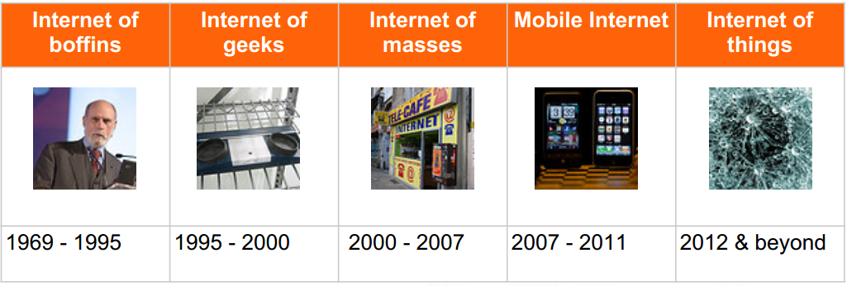
Internet Revolution

Slide 4

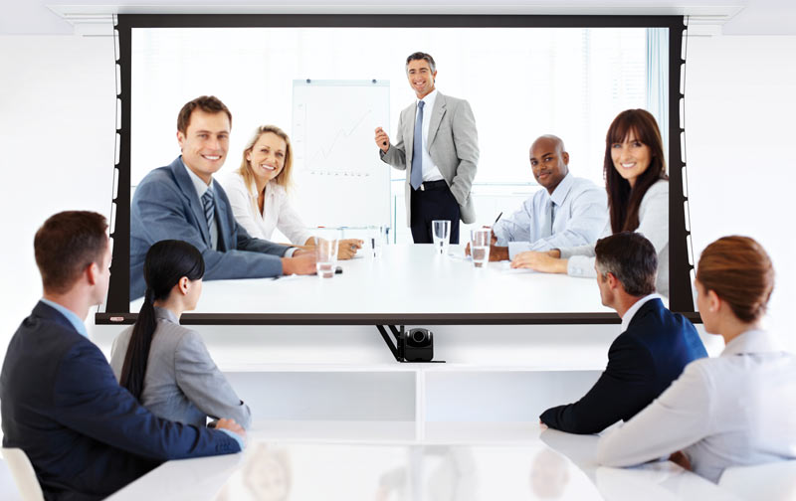
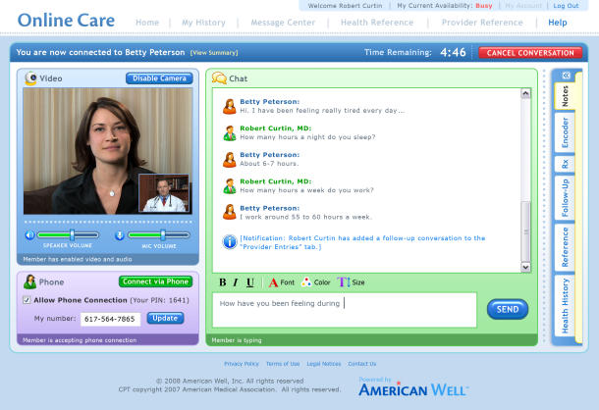
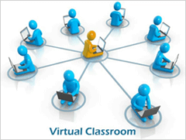



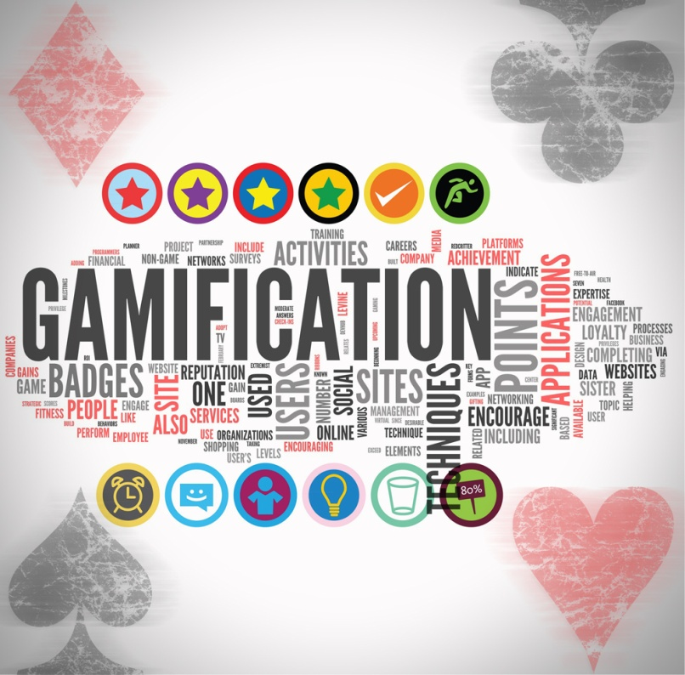




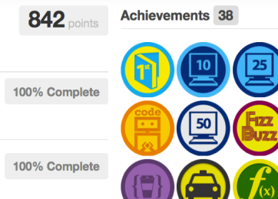

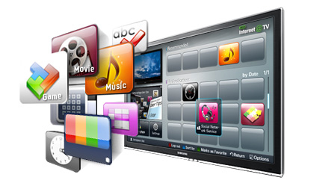
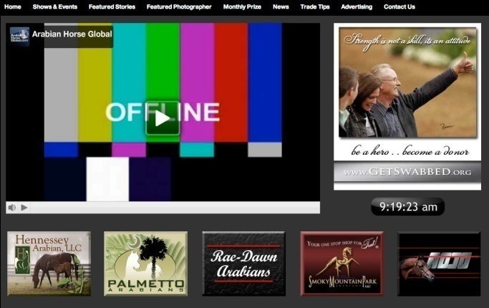
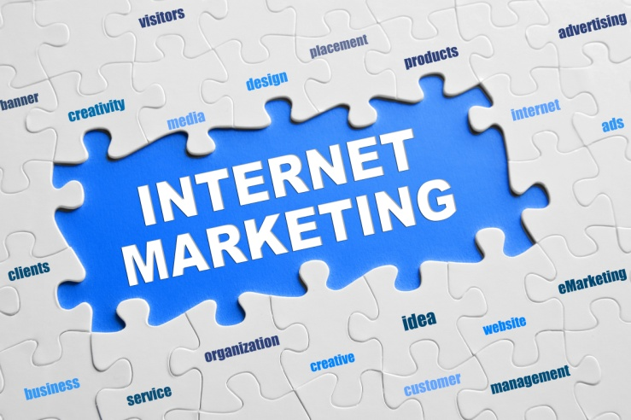

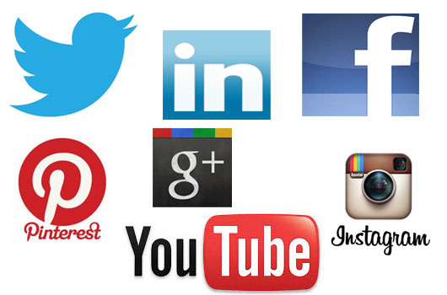






Impact of the Internet
Education
Business
Communications
Entertainment
Medical/Health
Notes:
Impact of the Internet

Slide 5
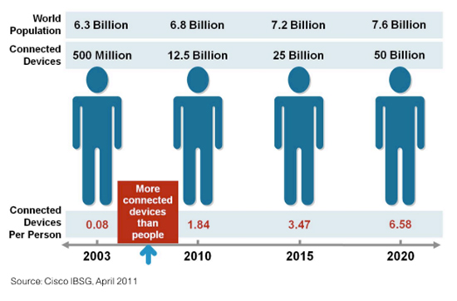
Internet Usage and Population Statistics

Slide 6
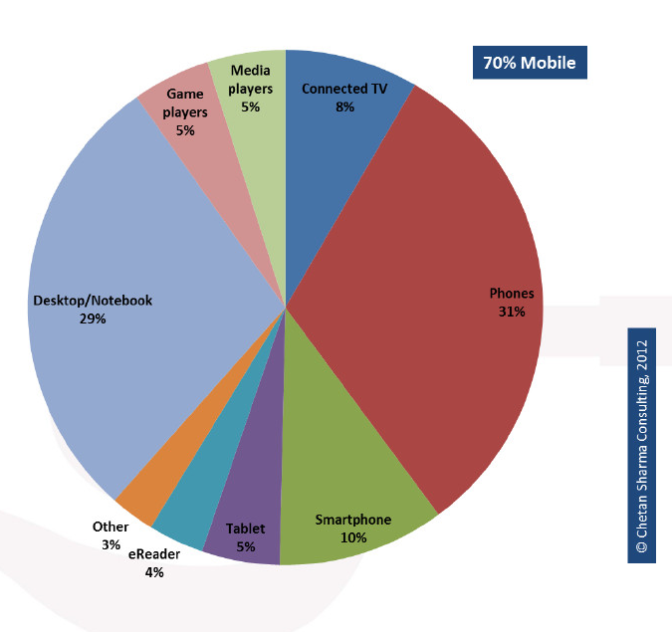
Connected World

Slide 7
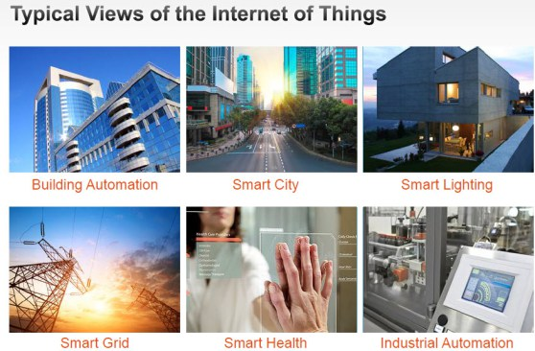
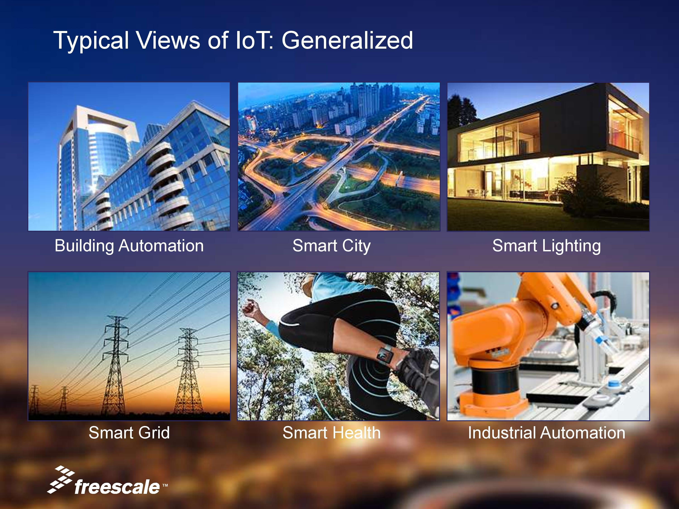
Typical Views of the Internet of Things
Industrial Automation
Smart Health
Smart Home
Smart City

Slide 8


What is the Internet of Things

Slide 9
The Internet of Things
“Internet of Objects”
“Machine-to-Machine Era”
“Internet of Everything”
(1) The Internet of Things, also called The Internet of
Objects, refers to a wireless network between objects,
usually the network will be wireless and self-configuring, such as household appliances.
------Wikipedia
(2) Internet of Things refers to the concept that the
Internet is no longer just a global network for people to
communicate with one another using computers, but it is
also a platform for devices to communicate electronically
with the world around them.”
--Center for Data and Innovation

Slide 10
The Internet of Things
(3) The term "Internet of Things" has come to describe a number of technologies and research disciplines that enable the Internet to reach out into the real world of physical objects.
------IoT 2008
(4) “Things having identities and virtual personalities operating in smart spaces using intelligent interfaces to connect and communicate within social, environmental, and user contexts”.
-------IoT in 2020

Slide 11
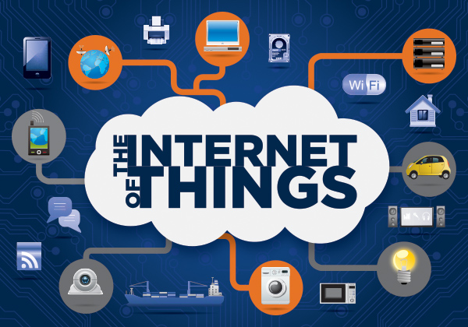
The Internet of Things
The term Internet of Things was first used by Kevin Ashton in 1999.
Refers to uniquely identifiable objects (things) and their virtual representations in an Internet-like structure

Slide 12
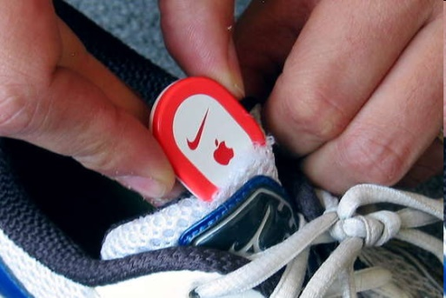
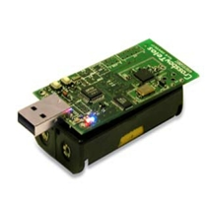
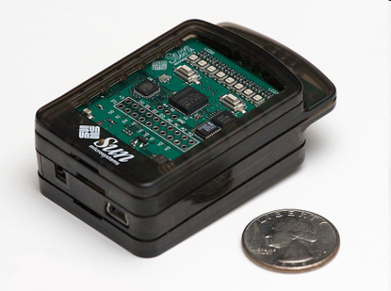
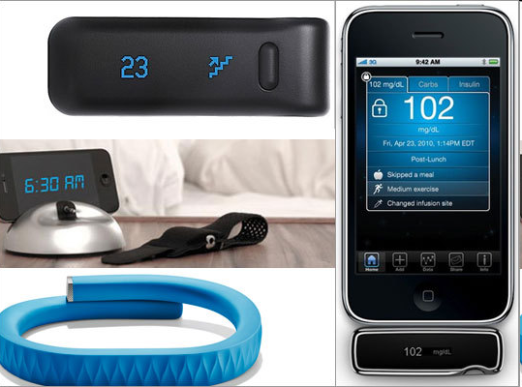
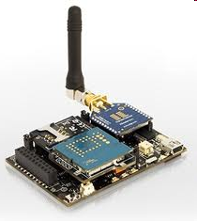
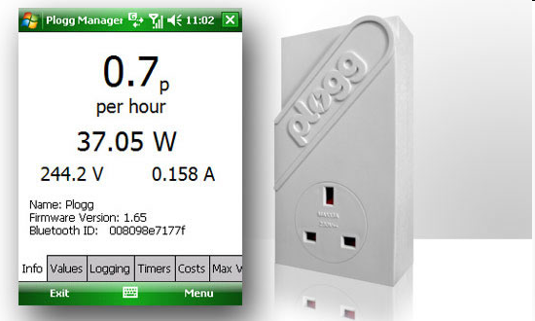
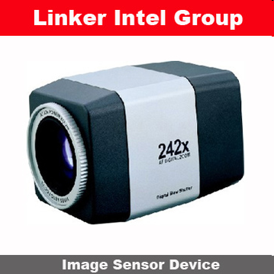
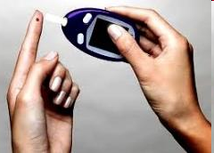
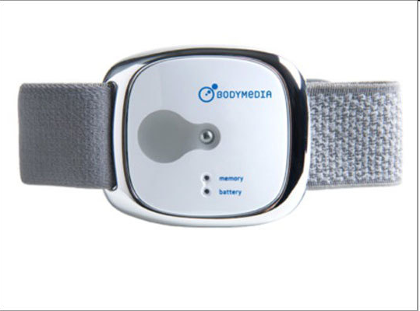
Sensor devices are becoming widely available
- Programmable devices
- Off-the-shelf gadgets/tools

Slide 13





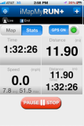
People Connecting to Things
ECG sensor
Internet
Motion sensor
Motion sensor
Motion sensor

Slide 14
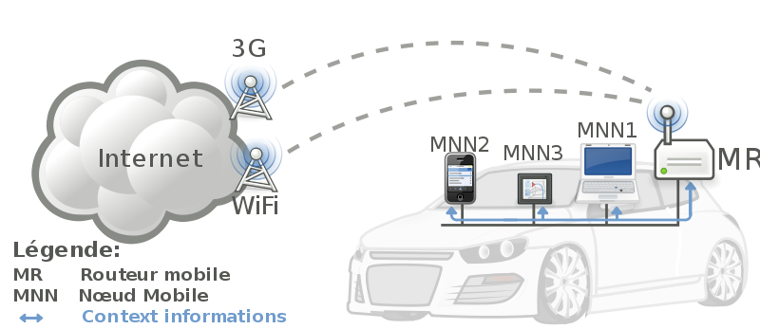


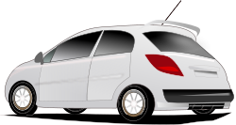
Things Connecting to Things
- Complex and heterogeneous
resources and networks

Slide 15






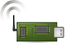
Wireless Sensor Networks (WSN)
End-user
Core network
e.g. Internet
Gateway
Sink
node
Gateway
Computer services
The networks typically run Low Power Devices
Consist of one or more sensors, could be different type of sensors (or actuators)

Slide 16
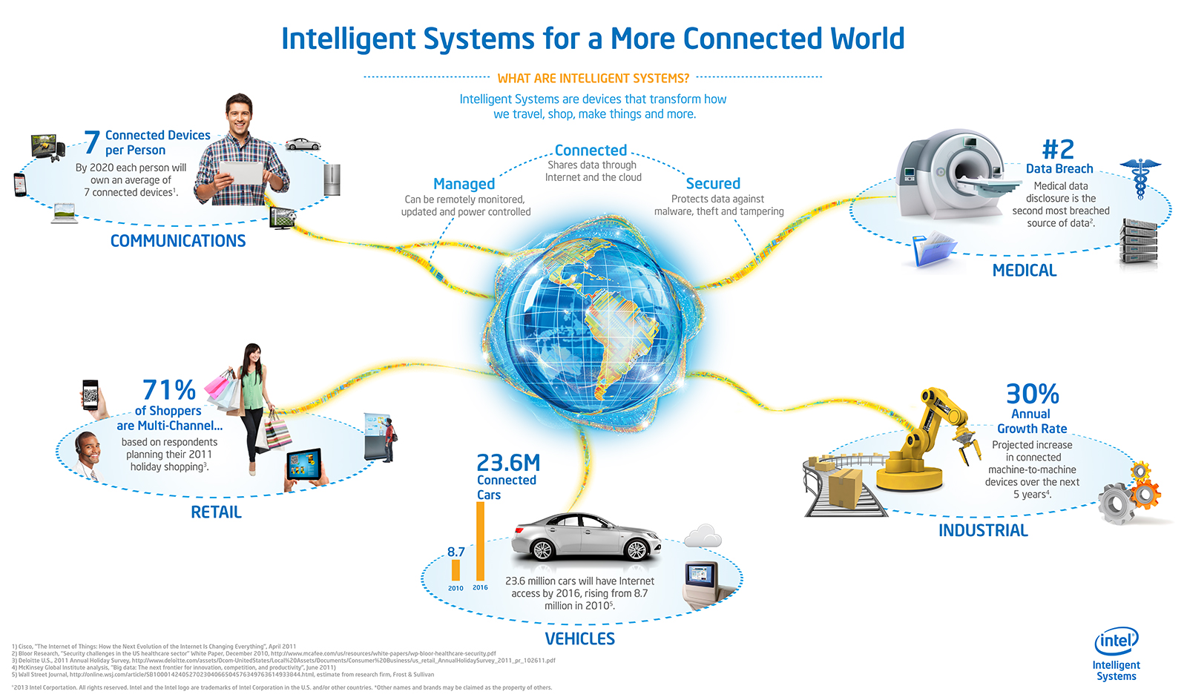
Opportunities
Source: http://blog.trentonsystems.com/internet-of-things-crosses-business-personal-boundaries/

Slide 17
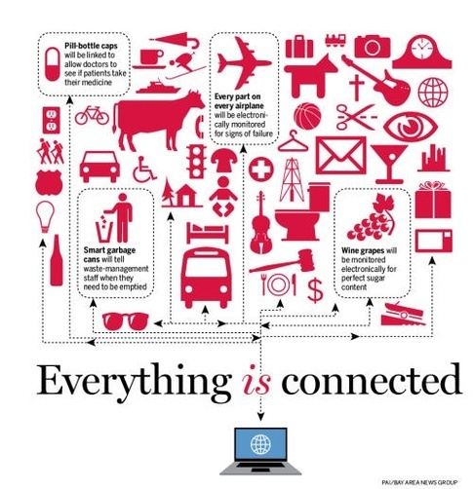

Slide 18
Characteristics
Ambient
Intelligence
Flexible
Structure
Event
Driven
Internet of Things
Semantic
Sharing
Complex Access Technologies
Notes:
AI: the autonomous and intelligent entities will act in full interoperability & will be able to auto-organize themselves depending on the context, circumstances or environment.
ED is to design the scheme depending on the need
FS means that hundreds and thousands of nodes will be disable and will be set to run.
CAT means that there’s several kinds of media such as vehicle stone that they need different access technologies.
SS is the machine can rend and send by themselves. No need to tell humanbeings

Slide 19
Enabling Technologies
RFID
Sensor
Smart Tech
Nano Tech
To identify and track the data of things
To collect and process the data to detect the changes in the physical status of things
To enhance the power of the network by devolving processing capabilities to different part of the network.
To make the smaller and smaller things have the ability to connect and interact.
Notes:
machine-to-machine interfaces and protocols of electronic communication
microcontrollers
wireless communication
RFID
Energy harvesting technologies
sensor technology
Location technology
Software
IPv6

Slide 20
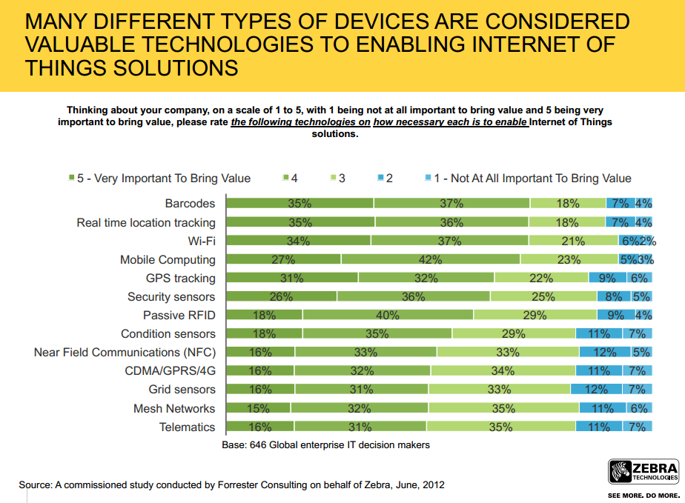

Slide 21
Technical Perspective
Sensing Layer
Communication Layer
Management Layer

Slide 22
Applications of IoT
Management
Education
Retail
IoT Applications
Food
Logistics
Pharmaceuticals
Notes:
Logistics – Tagging items on a UPS truck (now they use barcodes to be scanned) but not real-time. Using the newer technology all is in realtime.

Slide 23
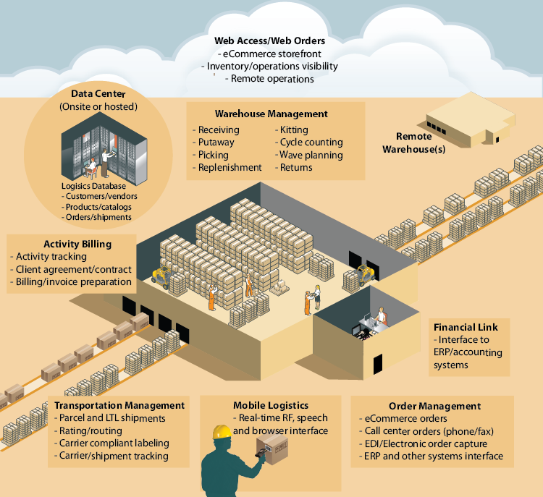
Management:
Data management
Waste management
Urban planning
Production management
...

Slide 24
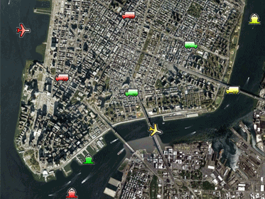
Logistics:
Warehouse, management
Inventory control
Port management
ETAs, ETDs
Ships, boats, containers, etc.
Executable code
…

Slide 25
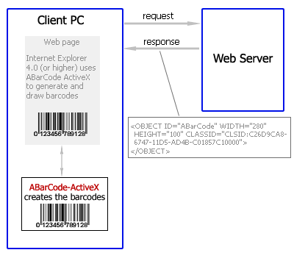
Retail:
Intelligent shopping
Bar code in retail
Electronic tags
…

Slide 26

Pharmaceuticals :
Intelligent tags for drugs
Drug usage tracking
Pharma. Product websites
--> Enable the emergency treatment to be given faster and more correct
Notes:
waste management, urban planning, sustainable urban environment, continous care, emergency response, intelligent shopping, smart product management, smart meters, home automation and smart events
Pharma. – Doctors managing patience during the day – realtime - managing heart rate, Temperature, etc.

Slide 27
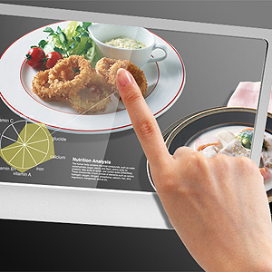
Food:
Control geographical origin
Food production management
Nutrition calculations
Prevent overproduction and shortage
Control food quality, health and safety.
Notes:
waste management, urban planning, sustainable urban environment, continous care, emergency response, intelligent shopping, smart product management, smart meters, home automation and smart events

Slide 28
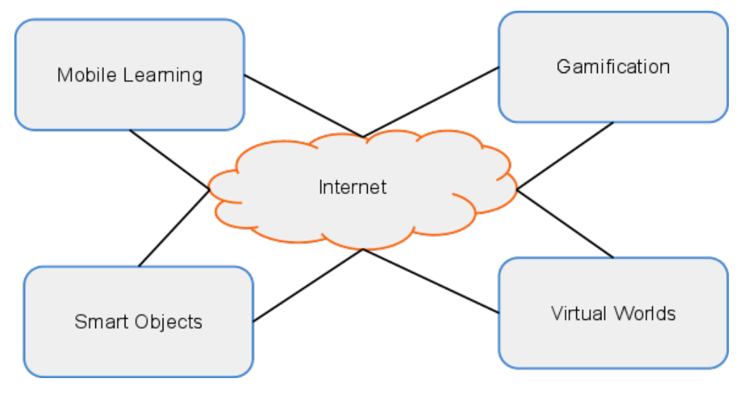
INTERNET OF THINGS
Notes:
http://blogs.princeton.edu/etc/2012/02/24/the-internet-of-things/
Education – When researching items and tagging them (Radio Frequency Identification) the data can be collected and monitored over a time period.

Slide 29

School Administration
Attendance Management
Voting System
Automatic Feedback Loops
Instructional technology
Media
Infor­ma­tion management
Foreign language learning
Notes:
Infor­ma­tion management: research data

Slide 30
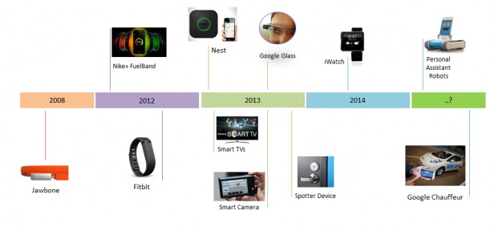
Smart Things Timeline

Slide 31
Challenges and Issues
Issues
Society: People, security, privacy
A policy for people in the Internet of Things:
Legislation
Environmental aspects
Resource efficiency
Pollution and disaster avoidance
Technological
Architecture (edge devices, servers, discovery services, security, etc.)
Governance, naming, identity, interfaces
Service openness, interoperability
Connections of real and virtual world
Standards
Notes:
Legislation: mandatory that policy keeps up with technology so that citizens gain confidence in the new technology
People’s momentarily context and roles can determine their attitudes towards new technology. An employee will resist his boss’ access to his or her mailbox while the same person may demand the same insight into the mailboxes of subordinates.

Slide 32
Challenges and Issues
IoT will inherit the drawbacks of the current internet on an infinitely larger, but more invisible scale
Privacy – will be a huge issue when implementing IoT
Identity - Online Fragmentation of Identity
Efficiency – speed - person loses identity and is an IP address
Decisions – do not delegate too much of our decision making and freedom of choice to things and machines
Balancing

Slide 33
Challenges and Issues
Transition to IPv6 – Internet protocol v6
Estalishing a common set of standards between companies, educational systems, and nations.
The same type of cabling,
The same applications or programming
The same protocol or set of rules that will apply to all
Developing energy sources for millions -even billions - of sensors.
Wind
Solar,
Hydro-electric

Slide 34
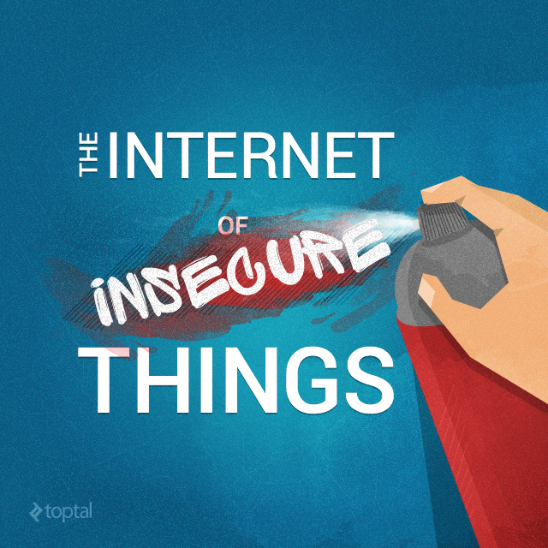

Slide 35
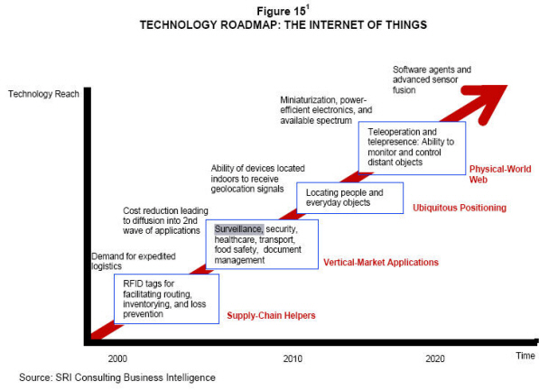
Technology Roadmap of IoT

Slide 36
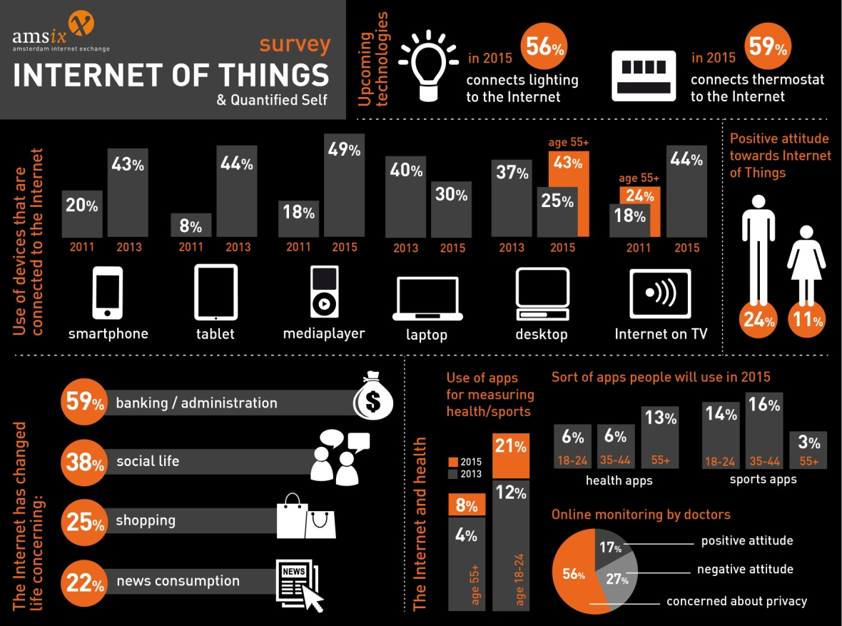
Future of IoT

Slide 37
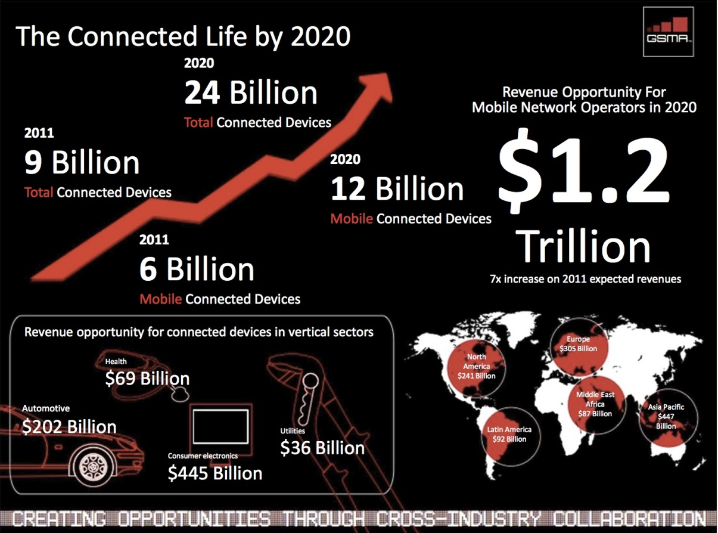

Slide 38
